Slide 1

Slide 1
Using Command Line Interface (CLI) to Manage Files & Folders
Partial list of Command Line Instructions (CLI)
CLS – Clear screen
REM – remark
@echo off
DIR – list files and Directories
CD – Change Directory
MD – Make Directory mkdir
DEL – Delete the file(s) specified
Del *.* delete the files in current directory
REN – Rename file X Y
COPY – Source Destination
COPY *.* – copy all the files into directory
RD – remove directory
TIME AND DATE
Notepad – create or edit text file
Type – view contents of a text file

Slide 2
Slide 1
Using Command Line Interface (CLI) to Manage Files & Folders (Cont’d)
Partial list of Command Line Instructions (CLI)
Whoami – display user and computer name
Move – move a file from one location to another
* (asterisk) – Wildcard that can represent any name
FC – File Compare
color – set the default console foreground & background colors
Dir > list.txt – output of “dir” is written to the file list.txt
Dir >> list.txt – output of “dir” is appended to the file list.txt
tree | more – Will fill the command prompt window with output and then pause
TIME AND DATE
Notepad – create or edit text file
Type – view contents of a text file
< input redirection (e.g. sort < numbers.txt)

Slide 3

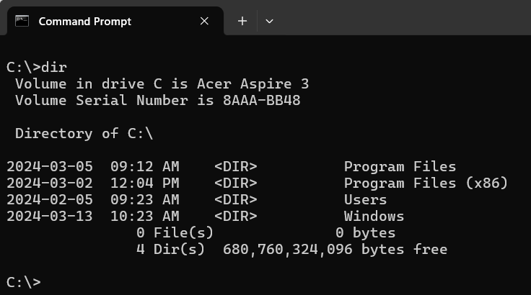
Slide 2
View files and folders in a directory – DIR
C:\USERS\USERNAME>DIR <Enter>
List files and Directories.
On C:\Users\Igork\ type DIR and press <Enter>
Options for the use of DIR commands :
- dir /p (page)
- dir /w (wide)
- dir *.txt
- dir /s – (system files)

Slide 4
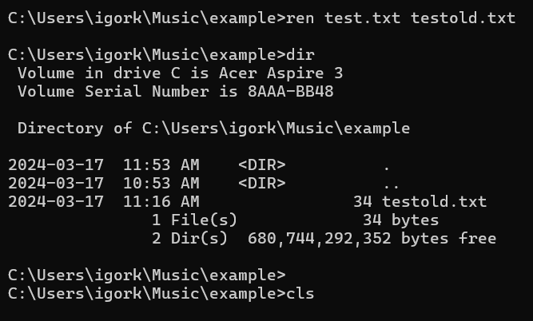


Slide 4
Clear Screen - CLS
On C:\Users\Igork\Music\example type CLS and press <Enter>

Slide 5
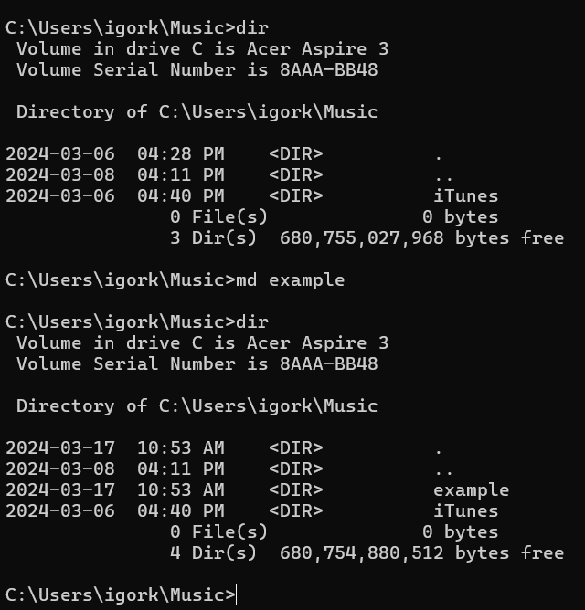

Slide 2
Create a new Directory (Folder) – MD
C:\USERS\USERNAME>MD example <Enter>
Make a new directory called example
On C:\Users\Igork\Music type MD example and press <Enter>
C:\Users\igork\Music\example

Slide 6
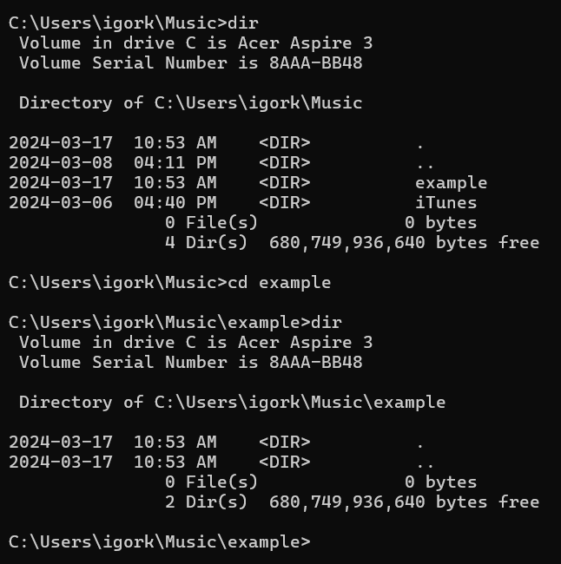

Slide 2
Change Directory (Folder) – CD
C:\USERS\USERNAME>CD example <Enter>
Switch to the new directory example and confirm by >DIR
On C:\Users\Igork\Music\example type CD example and press <Enter> to switch to folder example
C:\Users\igork\Music\example

Slide 7
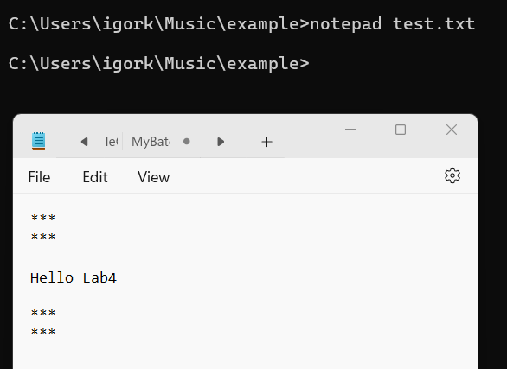
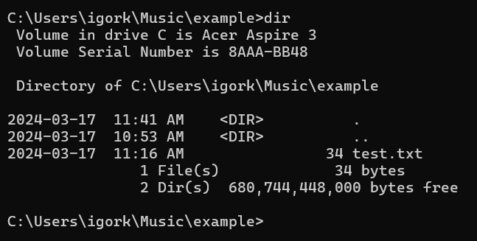
Slide 3
Create a text file called Test.txt using NOTEPAD App
On C:\Users\Igork\Music\example type NOTEPAD Filename and press <Enter> to start editing the document
After saving the Document called test.txt, verify that it was properly saved

Slide 8

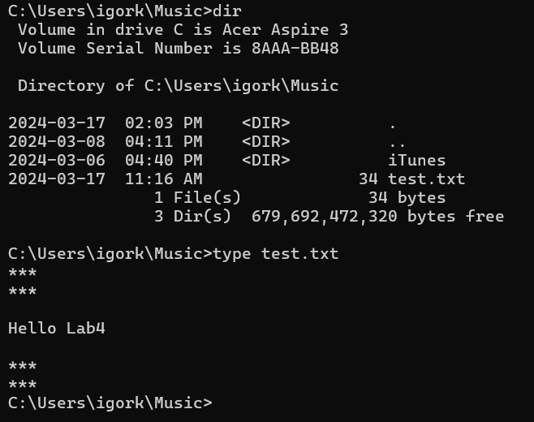
Slide 3
View content of a text file using Type command
File test.txt created with a NOTEPAD
Verify the content of test.txt, by using command type test.txt

Slide 9
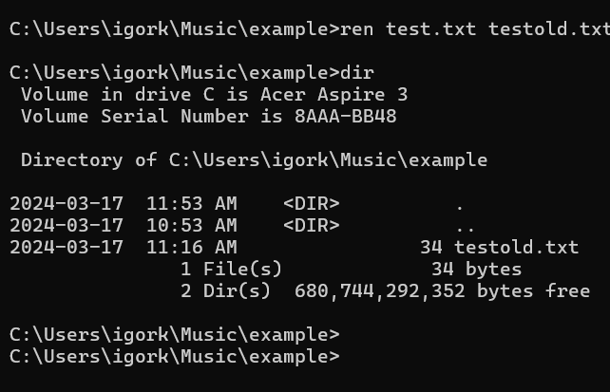
Slide 3
Rename a file – REN Y to X
On C:\Users\Igork\Music\example type REN test.txt testold.txt and press <Enter>
After renaming to testold.txt, verify that it was properly done

Slide 10
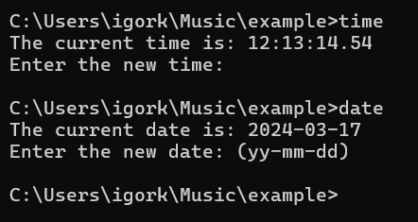
Slide 4
Display or set the system Time or Date
On C:\Users\Igork\Music\example type TIME and press <Enter>
On C:\Users\Igork\Music\example type DATE and press <Enter>

Slide 11
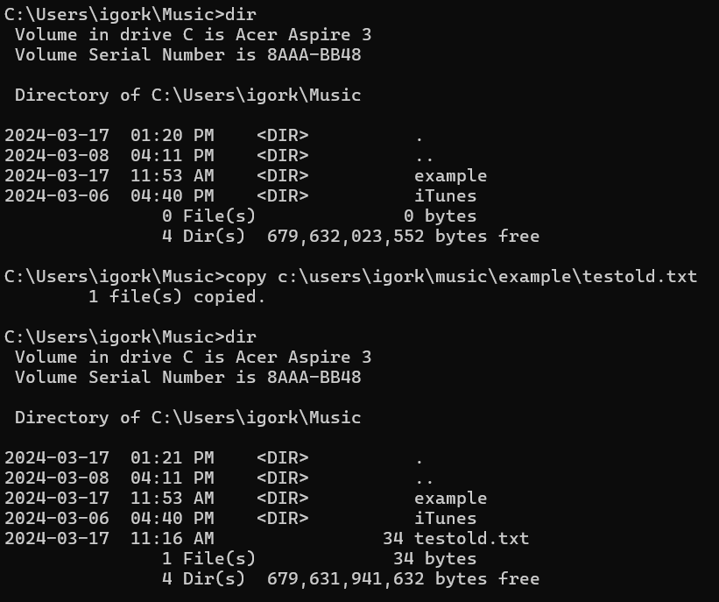

Slide 5
Copy file testold.txt (from source to current folder)
Copy example\testold.txt file to folder C:\Users\Igork\Music <Enter>
Verify existence of testold.txt

Slide 12

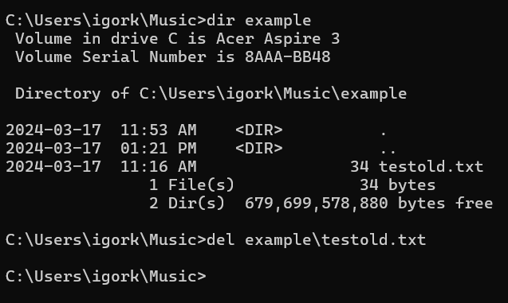
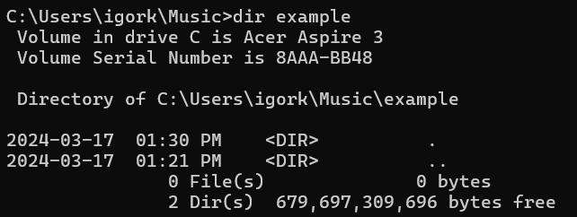
Slide 5
DEL - Delete file from a folder
del example\testold.txt file from folder example
File testold.txt was deleted from example folder

Slide 13
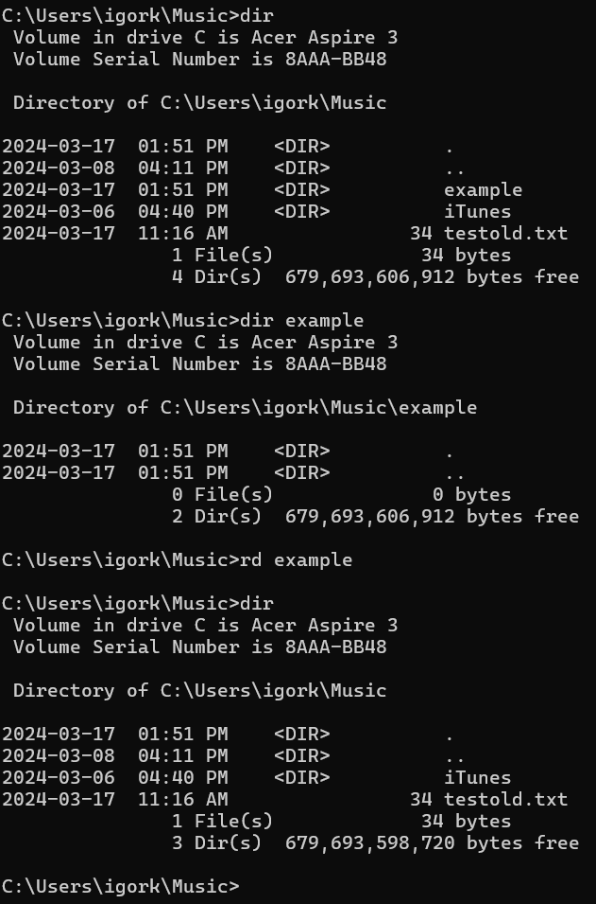
Slide 5
Remove Directory - RD
View (dir) contents of \Music directory
View (dir) contents of example directory to ensure that it is empty
Remove (rd) directory example
View (dir) contents of \Music directory

Slide 14
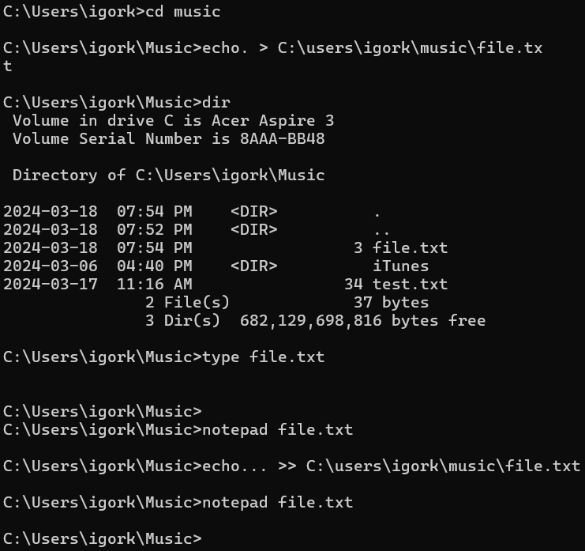
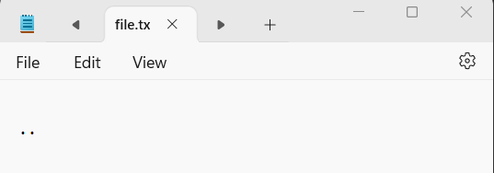
Slide 3
Create a text file called Test.txt using Redirection (>)
Write the command echo. > to create a file.txt, from the console.
After, verify that file.txt, it was properly created
Write the command echo. >> to append a line (..) to original file file.txt, from the console.
After, verify that file.txt, it was properly created with .. in the file.txt

Slide 15
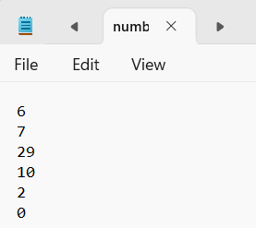
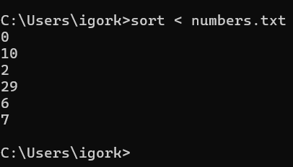
Slide 3
Input Redirection (<)
Input Redirection (<):
Takes input from a file numbers.txt instead of the keyboard.
Example: sort < numbers.txt will sort the contents of numbers.txt

Slide 16
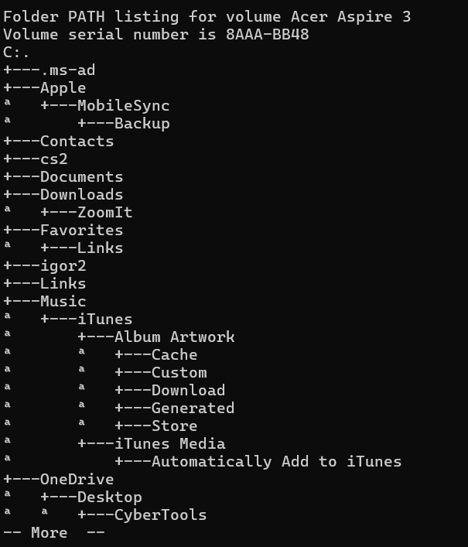
Slide 3
Tree – display directory listing
Tree | more
Will fill the command prompt window with output and then pause

Slide 17
Slide 1
Using Command Line Interface (CLI) in Batch Files
DOS (Disk Operating System)
Brand name of the first OS used on IBM personal computers
DOS was a product bought by the young Microsoft corporation when Bill Gates was 25 years old and rebranded as a Microsoft product
DOS used a CLI system
Many people call the CLI in Windows the DOS box
Also called the Command Prompt
Console is the proper name of the CLI in most other OSs such as Linux

Slide 18
Slide 5
CLI & Batch (.bat) Files
A .bat file name extension identifies a file containing commands that are executed by the command interpreter COMMAND.COM line by line, as if it were a list of commands entered manually, with some extra batch-file-specific commands for basic programming functionality, including a GOTO command for changing flow of line execution.
This example batch file displays Hello World!, prompts and waits for the user to press a key, and then terminates.
@ECHO OFF
ECHO Hello World!
PAUSE
To execute the file, it must be saved with the filename extension suffix .bat in plain text format, typically created by using a text editor such as Microsoft Notepad.
When executed, the following is displayed:
Hello World! Press any key to continue . . .

Slide 19
Slide 5
In-class Exercise
Write a batch file that:
Create on C:\USERS\CS drive the following directory structure:
NOTE: CS is the name of the first directory once you run CMD command
C:\USERS\CS\COMP_ENV\EXERCISE\PRACTICE
PRACTICE is a folder that has two subfolders: PartA and PartB
Each folder PartA and PartB has two subfolders: Theory and Labs
Theory has subfolders: Chap_5, Chap_6, Chap_11, Chap_12
Labs has subfolders: Lab_5, Lab_6, Lab_11, Lab_12
Write the command to create a file from the console in each directory.
Write the command to show the directory structure.
Write the command to show tree structure

